Slide 1
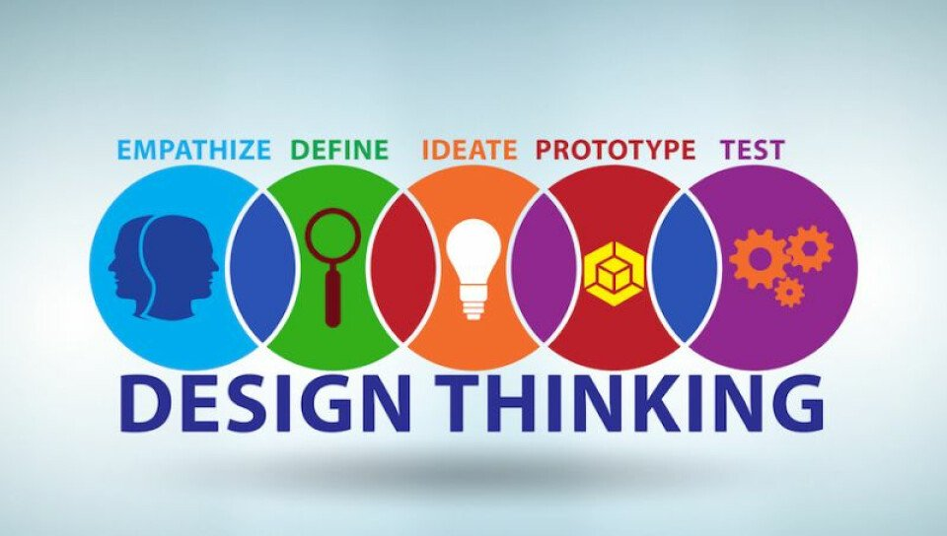
U20ITT615 – Design Thinking III Year / VI Semester

Slide 2
Course Outcomes
CO1 - Explain the fundamentals of Design Thinking and innovation. (K2)
CO2 - Empathize and analyze model action plan. (K2)
CO3 - Describe the principles of innovation and idea generation for product design. (K2)
CO4 - Apply design thinking techniques for given tasks. (K3)
CO5 - Apply the design thinking techniques for solving problems in various sectors. (K3)

Slide 3
Syllabus
UNIT I INTRODUCTION TO DESIGN
Introduction to elements and principles of Design, basics of design-dot, line, shape, form as fundamental design components. Principles of design - Introduction to design thinking - history of Design Thinking - New materials in Industry.
UNIT II- DESIGN THINKING
Design thinking process (empathize, analyze, idea & prototype), implementing the process in driving inventions, design thinking in social innovations. Tools of design thinking - person, costumer, journey map, brain storming, product development.
UNIT III- INNOVATION AND PRODUCT DESIGN
Art of innovation, Difference between innovation and creativity, role of creativity and innovation in organizations. Creativity to Innovation. Teams for innovation, Measuring the impact and value of creativity. Problem formation, introduction to product design, Product strategies, Product value, Product planning, product specifications
UNIT IV – DESIGN THINKING FOR STRATEGIC INNOVATION
An exercise in design thinking – implementing design thinking for better process. Implement design thinking process in various Industries. Design thinking for Startups.
UNIT V – DESIGN THINKING IN VARIOUS SECTORS
Case studies in Information Technology, Finance, Education, Management and Retail sector. Analyze and Prototyping, Usability testing, Organizing and interpreting results

Slide 4
Text Books and References
Text Books:
Change by design, Tim Brown, Harper Bollins(2009)
Design thinking in the Class Room by David Lee, Ulyssespress.
Product Design and Manufacturing by A.K. Chitale and R.C. Gupta, PrenticeHall
Reference Books:
Design the Future , by Shrrutin N Shetty , NortonPress
Universal principles of design- William lidwell, kritina holden, Jillbutter.
The era of open innovation –chesbrough.H
Websites:
https://drive.google.com/file/d/1cplqb1eOWnoNMhFWNP8TyYLF2qHdGY_K/view
https://nptel.ac.in/courses/110/106/110106124/#

Slide 5
UNIT III
UNIT III - INNOVATION AND PRODUCT DESIGN
Art of innovation, Difference between innovation and creativity, role of creativity and innovation in organizations.
Creativity to Innovation. Teams for innovation, Measuring the impact and value of creativity.
Problem formation, introduction to product design, Product strategies, Product value, Product planning, product specifications

Slide 6
Art of innovation
Innovation – Doing new things
Innovation is about creating value and increasing efficiency , and therefore growing your business.
Without innovation, new products, new services, and new ways of doing business would never emerge, and most organizations would be forever stuck doing the same old things the same old way.

Slide 7
ART OF INNOVATION
The Art Of Innovation | 10 Things To Learn From Guy Kawasaki

Slide 8
10 Things To Learn From Guy Kawasaki
Make meaning, not money
Make a mantra, not mission
Jump to the next curve
Roll the dice
Don’t worry, be crappy
Let 100 flowers bloom
Polarize people
Churn baby, churn
Niche Thyself
Don’t let the bozos grind you down

Slide 9
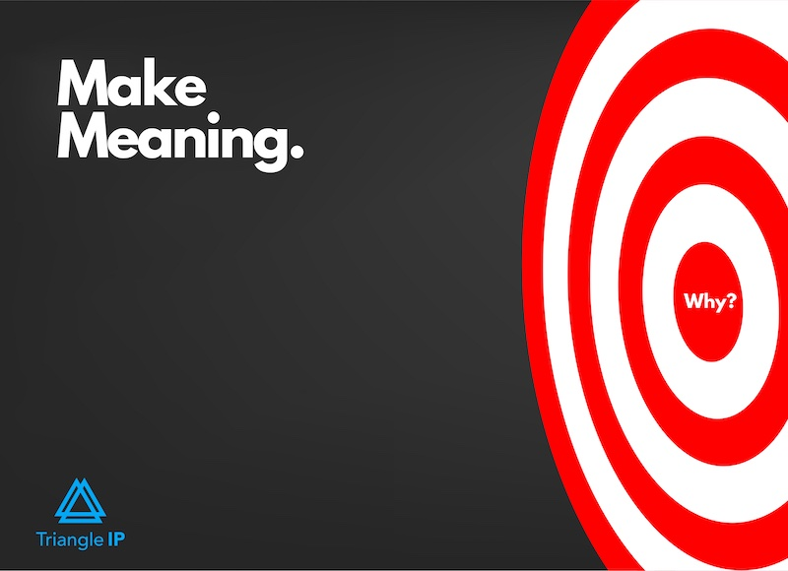
Make Meaning, Not Money

Slide 10
Make Meaning, Not Money
Innovation is about offering value and changing the world.
If you innovate to bring a difference in people’s lives, the money will follow eventually. But money shouldn’t be your first agenda.
When I shared this modified version in our next zoom meeting, everybody said ‘yes, this is what all our clients would want.’

Slide 11

Make A Mantra, Not Mission

Slide 12
Make A Mantra, Not Mission
Because according to Guy, your meaning leads to a mantra. And the mantra is the crux of the difference you want to make.
Chuck your 50-word mission statement. Stick to a 2-3 word mantra that represents your aim of the innovation.
I realized that if we can narrow down our vision to 2-3 words, this can make our path more clear.

Slide 13
Make A Mantra, Not Mission
Guy gave an example where he says to learn from FedEx: ‘Peace of mind’ whenever and wherever you go because FedEx is at your service.

Slide 14
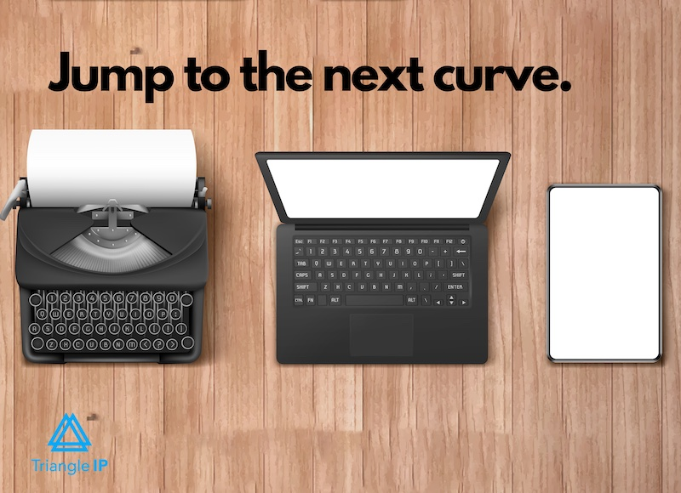
Jump To The Next Curve

Slide 15
Jump To The Next Curve
Don’t stick to achieving 10% better from your current innovation.
Create something new instead of continuously working on the existing product.
Don’t limit yourself and stick to the same curve. Move to the next one.

Slide 16
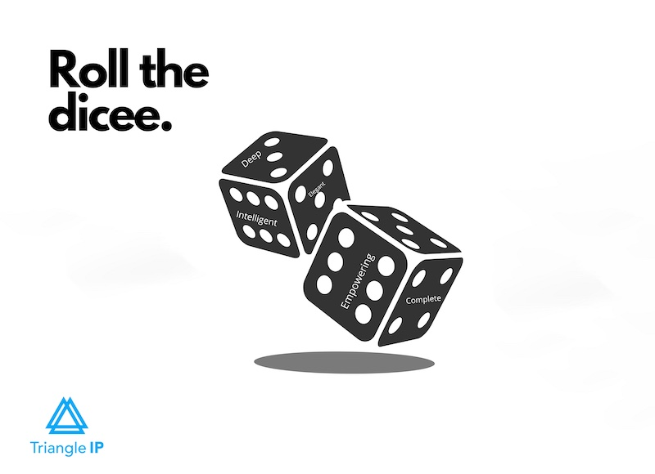
Roll The DICEE

Slide 17
Roll The DICEE
Deep – The features and functionalities of great innovation are deep.
Intelligent – At the same time, great innovation is intelligent. Ford’s MyKey can control the top speed of the car through the key. Quite smart!
Complete – You can differentiate great products from mediocre by their totality, their completeness.
Empowering – Innovations that enhance your life and way of working are empowering products. They have the capability to change your life.
Elegance – An innovation offers a great design and user experience.

Slide 18
Don’t Worry, Be Crappy
Don’t wait for perfection when you innovate. A valuable innovation can have elements of crappiness, Guy suggests.
So, don’t worry about the flaws. Instead, ship your innovation with revolutionary outcomes. If it’s on the next curve, elements of crappiness don’t matter.
Guy shares an excellent example where he tells a story of John Logie Baird who introduced the first TV set in 1926, it wasn’t a flat-screen, and rightfully so. The set was a mechanical version to transmit pictures without a film. The images were of low quality, but the invention paved the way for electronic TV.
Had Braid worried too much about the existing flaws, he wouldn’t have been voted the second most famous Scottish scientist.

Slide 19
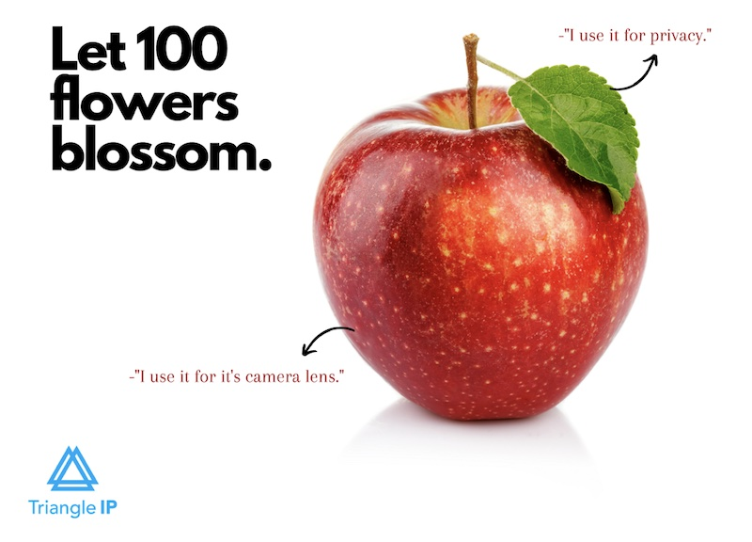
Let 100 Flowers Blossom
.

Slide 20
Let 100 Flowers Blossom
Your product may solve a particular problem. And you may have a specific audience in mind. Later, your product could be used & perceived in a new way by people you had never thought of.
When Apple launched Macintosh, they aimed it as offering database, word processing, and spreadsheet. But Macintosh became synonymous with desktop publishing.
The positioning of your innovation ultimately comes down to what consumers decide. But don’t worry about that. Allow a hundred flowers to bloom from one seed and cherish a garden.
.

Slide 21

Polarize People
.

Slide 22
Polarize People
Be ready to polarize people with your innovations. Who says a great innovation doesn’t have critics? Your innovation might make only a small segment of people happy.
Apple is a typical example. Those who don’t use an iPhone criticize it for its cost and niche features. But only an apple user has the heart to shell out what they pay for.
So, don’t worry if your innovation draws negative attention. Worry if people are indifferent about it.
.

Slide 23
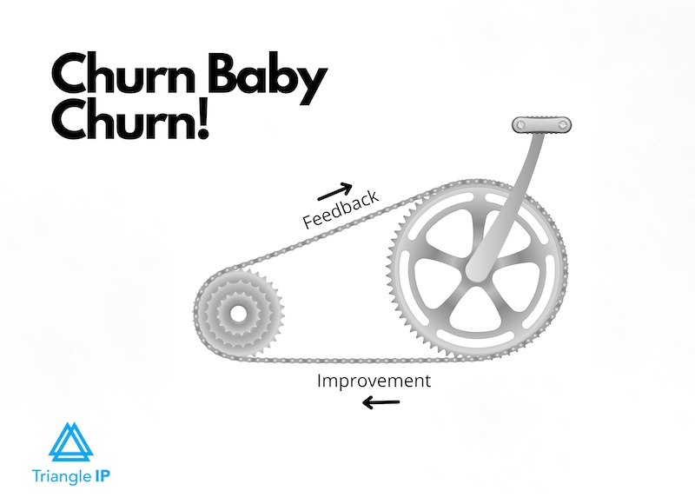
Churn Baby, Churn

Slide 24
Churn Baby, Churn
When you ship your product with a bit of crappiness, you have a scope to improve. Make new versions of your innovation, and then create another better version. Keep evolving to make a great product.
“Innovation is not an event; it’s a process,” quotes Kawasaki.
Facebook didn’t become the most loved social media platform on its first day. With time it evolved and became what it is today. After all, Rome was not built in a day.

Slide 25
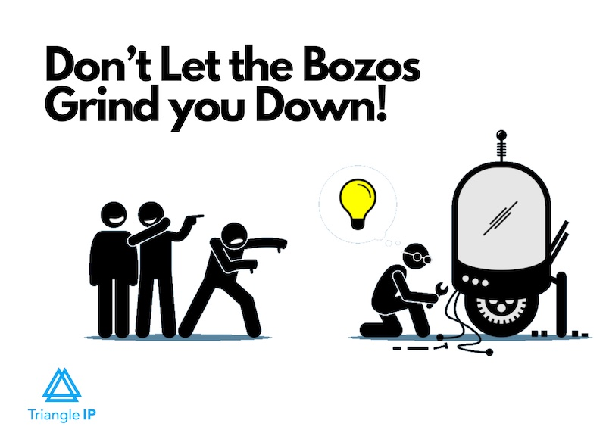
Don’t Let The Bozos Grind You Down

Slide 26
Don’t Let The Bozos Grind You Down
Naysayers will interrupt and criticize. Don’t let bozos bog down your spirits.
Bozos are either the losers themselves or the rich and famous people you might perceive as correct in negating your meaning and mantra. They are still stuck in their curves and don’t appreciate the next curve you are standing at.
And here is your bonus tip Guy Kawasaki advises every innovator.

Slide 27
Perfect your Pitch
After your innovation, the challenge of pitching your product looms around. Guy suggests following the 10-20-30 rule of pitching.
Have 10 slides to proposition your product. Explain these slides in 20 minutes and use 30 points fonts. With these fonts and 10 slides, you are bound to explain your innovation succinctly—need of the time.

Slide 28
Art of innovation
Types of Innovation
Incremental Innovation: It is a common type of innovation. In this, the existing technology is increased and utilized to have a greater output.
Disruptive Innovation: The other name of disruptive innovation is stealth innovation. In this, the new technologies are applied in the company to have a position in the market.
Architectural Innovation: In this type of innovation, the skills and technologies are updated and applied in different markets. It is done in order to increase customers and satisfy the existing ones.
Radical Innovation: Radical innovation is defined as the way of thinking during the process of innovation. New industries are formed with the help of this innovation.

Slide 29
Art of innovation
Types of Creativity
Deliberate and Cognitive Creativity: People who have this kind of creativity are considered to be purposeful. Such people are knowledgeable, and they use their skills to perform a particular course of action. People having this kind of creativity are good at research-work, problem-solving, and investigation.
Deliberate and Emotional Creativity: As the name suggests, people under this category are emotional and are driven by their emotions. The creativity of such people is balanced.
Spontaneous and Cognitive Creativity: People under this category do not over-think. Such people instantly look for solutions. People are spontaneous in their theories and solutions.
Spontaneous and Emotional Creativity: People under this kind of creativity are spontaneous and are driven by their emotions. This kind of creativity is required for scientific breakthroughs, spiritual discoveries, and philosophical ideas.

Slide 30
Difference between Creativity and Innovation
S.NO. | CREATIVITY | INNOVATION
1. | Creativity is the process of creating new products. | On the other hand, innovation is the process of implementing ideas and technologies so that the goods and services are renewed.
2. | Creativity can be tangible or intangible. | Innovation is majorly intangible.
3. | The word create/ creativity was first used in the 14th century. | The word innovation came into being in the 16th century.
4. | In creativity, new products are formed. | In innovation, new ideas and technologies regarding goods and services are formed.
5. | Creativity is an imaginative process. | Innovation is a productive process.

Slide 31
6. | Creativity is related to brainstorming and thinking about new ideas. | Innovation is related to introducing new ideas and technologies to carry out production smoothly and efficiently.
7. | There is no money consumption in creativity. | There is money consumption in innovation.
8. | The risk factor is negligible in creativity. | The risk factor is quite apparent in innovation.
9. | Creativity is about formation. | Innovation is all about bringing change.
10. | Creativity is immeasurable and cannot be quantified. | Innovation is measurable and quantifiable.
11. | Creativity precedes innovation. | Creativity is succeeded by innovation.
12. | Creativity may or may not involve an organization. | Innovation involves an organization for the production of services and goods.
13. | Creativity does not depend on materialistic things. | Innovation depends upon the monetary factor, i.e., how to implement the ideas into profit-earning.
14. | The novel ideas are communicated through creativity. | Inventions are communicated through innovation.

Slide 32
Role of creativity and innovation in organizations
Creative business ideas set companies apart from one another. It gives companies a competitive advantage. Without creativity and innovation, every company would follow the same pattern in business, marketing/promotion, or even the goods and services they may be selling. Creativity is essential for business today, especially when the market is dependent on innovative braking technology.
Creative thinking leads to the implementation of innovative ideas in the workplace, the collaboration of creative minds could push creative business ideas into reality. Once your employees can think outside the box and develop unique ideas, the possibilities are endless.
Creativity in the business Environment plays a vital role in driving innovation, differentiation, and overall success. It involves thinking outside the box, challenging conventional norms, and generating new ideas and approaches.

Slide 33
Role of creativity and innovation in organizations
Competitive Advantage | Benefits of Creativity and Innovation
Differentiation and Unique Offerings | Creativity helps businesses develop unique offerings and stand out from competitors in the market.
Problem-solving and Adaptability | Creative thinking enables fresh perspectives and innovative solutions to tackle challenges and adapt to change effectively.
Growth and Expansion | Creativity and innovation open doors to new opportunities and markets, driving business growth and expansion.
Employee Engagement and Satisfaction | Nurturing a creative culture boosts employee engagement and satisfaction, leading to higher productivity and retention.
Customer Satisfaction and Loyalty | Creative solutions address customer needs, enhancing satisfaction and building customer loyalty.
Continuous Improvement and Future-proofing | Creativity and innovation drive continuous improvement, ensuring businesses stay relevant in the long run.

Slide 34
Role of creativity and innovation in organizations
How to Foster Creativity Within Your Organization
Cultivating creativity in the workplace can indeed pose challenges, but witnessing creative innovations from other companies can inspire teams to tap into their own creative potential. The importance of innovation stands at the forefront of factors contributing to business success.
In fact, numerous CEOs prioritize creativity and the importance of innovation even above vision, integrity, and discipline, according to a study. To foster creativity and the importance of innovation, a well-developed innovation strategy is crucial. By encouraging fresh perspectives and approaches to business, organizations can enhance their problem-solving capabilities and unlock new opportunities.

Slide 35
Role of creativity and innovation in organizations
Sometimes it can be challenging to form a creative culture in an organization. Here are different ways that serve as a starting point for creating a culture of innovation in your organization.
Allow for creative autonomy:
Empower employees to approach new projects from their unique perspectives.
Give them the freedom to be creative and encourage thinking outside the box.
Form collaborative teams:
Create teams where members can contribute ideas and share responsibilities.
Bring together individuals with diverse skills and backgrounds.
Generate innovative solutions that encompass all aspects of the project.
Facilitate a culture of change:
Embrace change as a catalyst for Creativity and innovation.
Encourage employees to cultivate and implement new ideas aligned with their interests.
Emphasize that failure is a valuable learning opportunity and an essential part of the creative process.
Build a diverse team:
Assemble teams that encompass a variety of backgrounds and mindsets.
Foster a broader range of perspectives, leading to more creative discussions and innovative approaches.
Encourage the exchange of ideas among team members for continuous learning and effective innovation strategies.

Slide 36
Role of creativity and innovation in organizations
Encourage creativity in leadership:
Set the tone for the entire organization by exhibiting and promoting creative thinking.
Create an environment where team members feel comfortable sharing their ideas and know that their input is valued.
Get to know the unique strengths and skills of each team member to leverage their full potential.
Utilize creative digital marketing:
Go beyond traditional marketing approaches by finding unique and creative ways to showcase products or services.
Create engaging content that highlights the product’s value and appeals to customers’ emotions.
Encourage employees to contribute ideas and seek inspiration from customer feedback. Encourage employees to contribute ideas and seek inspiration from customer feedback.
Stay attentive to market trends:
Regularly study and keep up with market trends within your industry.
Identify cost-saving methods, explore new materials, and adapt business models to remain relevant.
Make informed decisions, develop effective strategies, and drive future success by staying informed.

Slide 37
Teams for Innovation
Innovative teams are groups of individuals collaborating to generate creative ideas, discover unique solutions, and successfully implement these ideas.
An innovative team requires high creativity, risk-taking, and ongoing learning. Examples of innovative teams include open innovation, self-managed, and Agile teams.
The purpose of innovative teams is to generate ideas and successfully implement solutions.
Additionally, creative teams help organizations remain competitive and relevant by developing new ideas, products, and services that meet the needs of their customers and stakeholders.

Slide 38
Teams for Innovation
Characteristics of innovative teams
Innovative teams play a pivotal role in promoting creativity, fostering collaboration, and cultivating a culture of continuous learning. These teams are instrumental in generating groundbreaking ideas, devising inventive products, and formulating cutting-edge processes. Found across diverse industries and sectors, these teams are united by their shared dedication to creativity, collaboration, and ongoing learning. Notable attributes of innovative teams encompass the following traits.
Open-Mindedness: Innovative teams are receptive to new ideas and viewpoints. These members embrace diverse perspectives and are open to exploring unconventional solutions.
Curiosity: Team members possess a natural curiosity that drives them to question assumptions, explore possibilities, and seek out new knowledge.
Collaboration: Collaboration is a cornerstone of innovative teams. Members actively share ideas, build on each other’s contributions, and work together to develop creative solutions.
Risk-Taking: Innovative teams are willing to take calculated risks. These individuals understand that failure is a stepping stone to success and view setbacks as learning opportunities.
Adaptability: These teams are adaptable and flexible in the face of change. Employees can quickly pivot, adjust their strategies, and embrace new approaches as circumstances evolve.

Slide 39
Teams for Innovation
Characteristics of innovative teams
Creativity: Creativity is the hallmark of innovative teams. Workers think outside the box, experiment with different approaches, and generate novel ideas.
Empathy: Members of innovative teams empathize with end-users and customers. Teams put themselves in others’ shoes to better understand needs, pain points, and preferences.
Constructive Discontent: Innovative teams maintain a healthy dissatisfaction with the status quo. These employees consistently seek ways to improve and innovate, even when things are going well.
Experimentation: These teams encourage experimentation. Workers will prototype, test, and iterate on their ideas to discover what works best.
Inclusive Environment: An inclusive environment encourages all members to contribute, regardless of their role or background. Innovative teams value all voices and foster an atmosphere of respect and collaboration.

Slide 40
Teams for Innovation
Characteristics of innovative teams
Time for Reflection: Innovative teams allocate time for reflection and introspection. Folks use this time to analyze successes, failures, and lessons learned to inform future endeavors.
Continuous Learning: Members are committed to continuous learning. Teams seek out opportunities to acquire new skills, stay updated on industry trends, and expand their knowledge base.
Constructive Conflict: Innovative teams welcome healthy debate and constructive conflict. These discussions lead to better ideas and solutions.
Autonomy: Teams have a degree of autonomy to make decisions and take ownership of their projects. This autonomy empowers members to be proactive and resourceful.
Results-Oriented: While focused on innovation, these teams are results-oriented. Folks strive to deliver tangible outcomes and measure their success by the impact of their innovations.

Slide 41
Teams for Innovation
Characteristics of innovative teams
Continuous Refinement: Innovative teams embrace an iterative approach. Members refine and evolve their ideas over time based on feedback and real-world insights.
Cross-Disciplinary Expertise: Diversity in skills and backgrounds enriches innovative teams. Members with varied expertise can approach challenges from different angles.
Resilience: Innovating can be challenging, so resilience is vital. Innovative teams bounce back from setbacks and stay committed to their goals.
External Engagement: These employees engage with external networks, attend industry events, and collaborate with experts outside the team to gain fresh insights.
Long-Term Vision: While addressing immediate challenges, innovative teams also maintain a long-term vision. Members anticipate future trends and position themselves for sustained innovation.

Slide 42
Measuring the impact and value of creativity
While there is no single right way to measure design thinking success, there are three main areas that are typically considered: customer impact, business value, and design activities.
Customer impact measures how design thinking has helped improve the experience of your customers or users. This can be quantified in terms of satisfaction scores, Net Promoter Score (NPS), or other customer feedback metrics.
Business value looks at how design thinking has helped drive tangible results for your organization, such as increased sales or reduced costs.
Design activity measures assess the quality and quantity of design work being produced, such as the number of prototypes developed, the number of design thinking projects completed, or the number of customers engaged throughout the process.
While all three of these areas are important to consider when evaluating design thinking success, the specific metrics will vary depending on your organization’s goals and objectives.

Slide 43
Measuring the impact and value of creativity
30 Design Thinking Measures of Success
How many customers spoken with?
How many days since speaking to a customer?
How do customers rate their satisfaction levels?
How has your Net Promoter Score been affected?
Has usability testing shown positive results?
How many referrals are you receiving?
What’s the sentiment of customer feedback?
How many positive pieces of customer feedback are there?
How has turnover been impacted?
How have costs been affected?
How many new customers have signed up?
How has your customer retention been impacted?
Is the design team satisfied with the design quality and process?
Do product teams feel connected to the customer?
Can employees offer useful customer insight?
How many employees have attended a design thinking workshop?

Slide 44
Measuring the impact and value of creativity
30 Design Thinking Measures of Success
How many employees can articulate human centered design?
Do employees report a greater sense of collaboration?
Does your organization use design as a strategic tool?
How many employees are trained in Design Thinking?
How many Design Thinking outcomes are on your roadmap?
How has speed to market been affected?
How many Design Thinking projects have been completed?
How many Design Thinking projects have been funded?
How many Design Thinking projects have been finished?
How many prototypes have been created?
How many iterations of a prototype have there been?
How many ideation sessions have been conducted?
How many complex problems have been solved?
How many different skills have contributed to each project?
How diverse are the participants in the Design Thinking process?
How are Design Thinking outcomes performing vs traditional methods?

Slide 45
Problem formation
Problem formation is a critical step in data thinking and innovation product design. It involves identifying, framing, and defining a problem in a way that enables effective problem-solving and guides the creation of innovative solutions. Here's how you can approach it:
Steps in Problem Formation
1. Identify the Context
Understand the broader environment or industry in which the problem exists.
Gather insights about stakeholders, market trends, and user needs.
Example: In healthcare, identify rising patient dissatisfaction with appointment scheduling systems.
2. Define the Core Problem
Pinpoint the issue affecting users, businesses, or systems.
Ensure the problem is specific and actionable.
Example: "Patients face delays and confusion in booking appointments due to outdated systems."

Slide 46
Problem formation
3. Understand the Stakeholders
Identify who is impacted by the problem (users, customers, employees, etc.).
Gather perspectives through interviews, surveys, or observational studies.
Example: Patients, hospital staff, and administrators may all face challenges in the scheduling process.
4. Analyze the Root Cause
Use tools like 5 Whys, Ishikawa Diagrams, or System Mapping to dig deeper.
Differentiate between symptoms (e.g., long wait times) and root causes (e.g., lack of real-time data).
5. Leverage Data Thinking
Ask how data can help understand or solve the problem.
Identify key metrics, patterns, or anomalies that provide actionable insights.
Example: Analyze historical scheduling data to find peak times, bottlenecks, or inefficiencies.
6. Formulate the Problem Statement
Write a clear, concise statement that includes:
Who is affected.
What the problem is.
Why it matters.
Desired outcomes.

Slide 47
Introduction to Product Design
Product design is the process involving complete development, innovation, and designing a product that can used by customers and fulfills their needs. It involves different stages where the development of a product takes place.
A product needs to satisfy customers’ needs and meet market requirements. Also, the design should be cost-effective and completely new and creative.
Importance of Product Design:
Product designing helps many industries and businesses to grow in the market. It plays a very crucial part in everyone’s life. It encourages creative thinking and innovation. New ideas contribute significantly to products and change the way they look.
Positive impact on society.
People’s perception changes the way they look at a product.
It helps other industries to sell their product more easily.

Slide 48
Introduction to Product Design
Step involved in Product Design:
Selecting a product: It is very important to select a topic which is based on peoples interest, and which satisfy the needs of society. The process involves research, data analyzation and observation. Research should be based on and around that product so that more users are interested in your product.
Ideation: After proper research on the product, try to make the product practical and user friendly by designing a basic idea of that product. Ideating involves different process-
Problem statement: Before entering into the main part of product designing it is crucial to define problem statements and problem which are important to address are developed in such a way that it solve users problem.
Involvement of all team members: All team members should be part of the process so that different ideas and solution are implemented properly. Everyone’s opinion are unique and help in overall development of product easily
Idea validation: Ones all ideas are selected it should be written or drawn so that the product looks practical and easy to go forward in the process of development.
Selection of material: Material selection is very crucial process in the development of a product. Materials are broadly classified into metals, semiconductors, natural materials like wood, ceramics and plastic. Before selecting a material for you product also keep in mind about its cost ,weight, properties, lifespan, availability and environment impact.

Slide 49
Introduction to Product Design
Prototyping: Prototyping is the process in which a model of the product is made or designed which is in working condition and is complete replica of the finished product. It is very fundamental process in product designing which help to make a conclusion about a product and suggest what are the changes required to improve the product. prototyping can be analyzed to improve the user experience. Prototype can be giver to people so that they can give their feedbacks and suggest changes.
Development: When all the above process are executed then its time to develop the real product and design the product to its fullest. Work on reviews and people feedbacks given based on your prototype model . Solve the problems which are seen in the prototype to improve people’s experience while they are using that product that will increase people’s interest in your product. designing should be done in such a way that it is cost effective as well as vey pleasing to customers. Show your creativity and innovate a completely different design which has to become center of interaction for all .
Testing: Testing as the name suggest is done properly keeping in mind of the following condition:
Test the design, weather it is good for that product.
Identify any defects and flaws in the designed product.
Test the durability of the designed product.
Test the designed product for different environment and cases.
Check the quality of the product.
Documentation: It is important to document your product and decide the other features of the design. There are some regulation which the finished product must met like safety, environment impact and other certification based on your product.
Feedback: People feedbacks are very important. You can work on your design and improve if required. Identify the mistakes and try to work on that mistake.

Slide 50
Introduction to Product Design
The Problem in Product Design:
Competition: It is important to understand market trends and work on trending topics. Different sectors compete with each other to develop the same product. In that case product designers face a lot of competition. New ideas has to be presented to the customer to stand out in market.
Lack of research: Product designers often face this problem. They do not have much knowledge about the product which certainly end up giving up. A proper research is very important before starting a project.
Budget constraints: Product development and designing need a good budget to start working whereas most of the product designers do not have enough budget. This could result in failure .
Inadequate resource: Most of the time people do not have enough resource to start their project and eventually manage to just satisfy customer needs.
How to solve and tackle problems in Product Design?
Try to be unique and do not follow anyone.
Try to research before starting a project
Before starting your project, fix the budget.
Use the free resources available on internet.

Slide 51
Introduction to Product Design
Advantages of Product Design:
Competitive environment: There’s always a competition between different groups to create the best out of there product so that it can easily become successful and stand out among all customers .
Personalization: The designer has full freedom to change the product design according to his choice and make the product more attractive.
Increase Problem: Solving skills-while working with product designing it increases the creativity and problem solving skills .
Scalability: It is developing field and well defined products are easier to scale among users. You can increase the popularity of a product by showing your designing skills.
Creativity and innovation: Design thinking increases your creative thinking and ability to explore different, unconventional and innovative ideas.
Problem solving skill: Working on different ideas and products increases the power of thinking and significantly increases you problem solving skills. It can be developed during designing a product.
Disadvantages of Product Design:
Designs may be harmed if there are too many flaws.
The high cost of design may have an impact on improvements.
Reduced variety results in decreased consumer appeal.

Slide 52
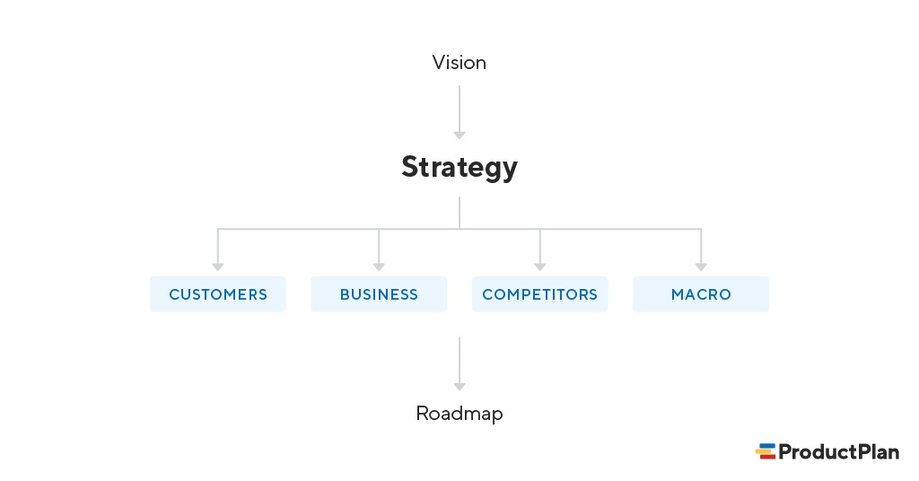
Product strategies
A product strategy is a high-level plan describing what a business hopes to accomplish with its product and how it plans to do so. The strategy should answer key questions such as who the product will serve (personas), how it will benefit those personas, and the company’s goals for the product throughout its life cycle.

Slide 53
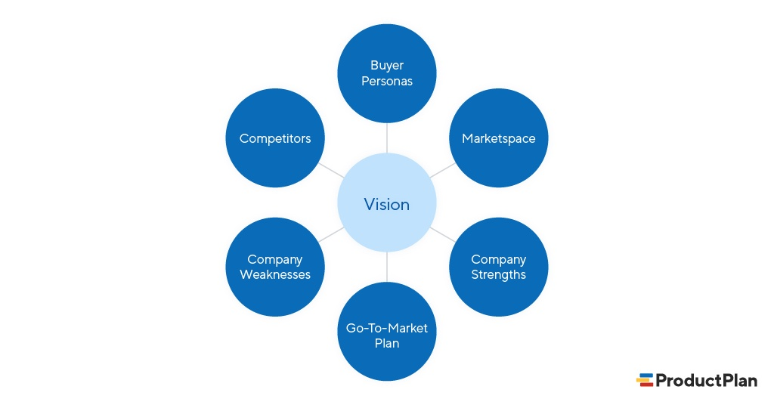
Product strategies
A Product Strategy Template
Here is a template you can use to follow the three-step process above.
Define your vision.
Add bullets to describe each of the outer circles above—competitors, personas, etc. During this exercise with your team, a picture should emerge of the problem you hope to solve for your market, for example, and the people and businesses it will help.
The exercise should help you develop a vision for your product.

Slide 54
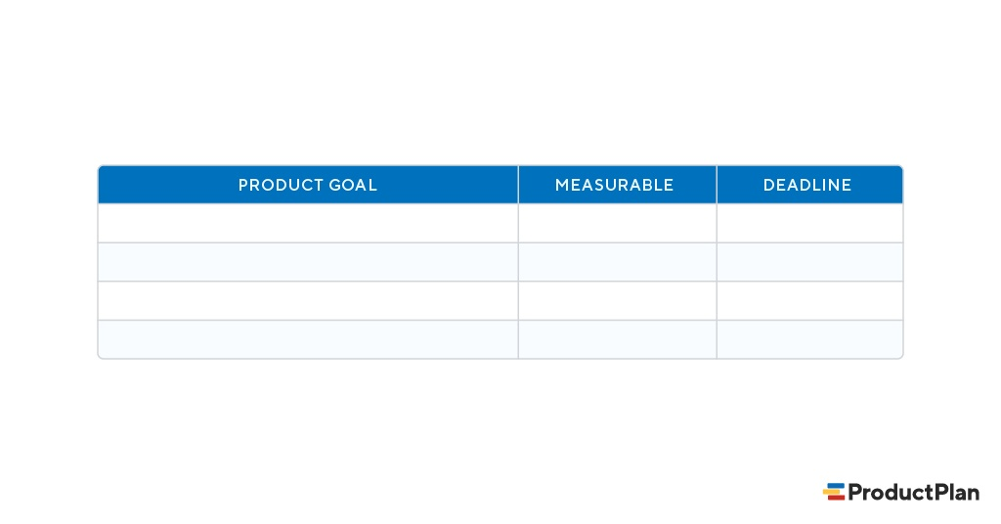
Product strategies
A Product Strategy Template
Establish your product goals.
Next, add your goals for the product. For each goal, decide on a quantifiable way to track its success and set a deadline as well.

Slide 55
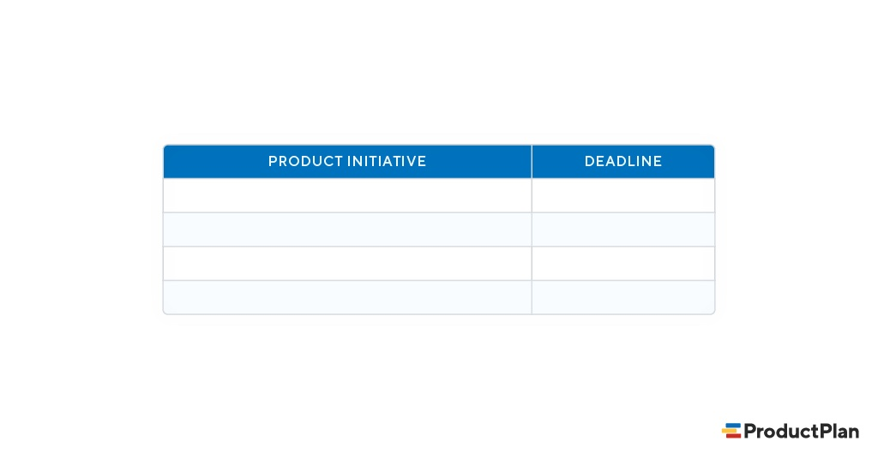
Product strategies
A Product Strategy Template
Create your product initiatives.
Now it’s time to translate your product goals into high-level themes that you can add to your product roadmap. Once they’re on the roadmap, your cross-functional team will review these themes, break them into detailed tasks, and begin working on them.

Slide 56
Product strategies
What are the Key Components of a Product Strategy?
Product management expert Roman Pilcher suggests a strategy should contain the following key elements:
The market for the product and the specific needs it will address.
The product’s key differentiators or unique selling proposition.
The company’s business goals for the product.
Another way to understand this is that a product strategy should include the following three components:
1. Product vision
As we discussed above, product vision describes the long-term mission of your product. These are typically written as concise, aspirational statements to articulate what the company hopes the product will achieve. For this reason, a product vision should remain static.
For example, Google’s early vision statement for its search engine was, “Organize the world’s information and make it universally accessible and useful.”

Slide 57
Product strategies
2. Goals
A product vision should lead to high-level strategic goals. These goals will, in turn, influence what the team prioritizes on its product roadmap. Examples of product goals include:
Increase free-trial downloads by 50% in the next 6 months
Improve our average customer rating by one star on major product-review sites
Generate $3MM in revenue within 12 months
Using SMART goals is the best approach to utilize when setting goals for your product strategy. Like product roadmaps, goals should be specific, measurable, attainable, relevant, and time-bound.
3. Initiatives
Initiatives are the strategic themes you derive from your product goals and then place on your roadmap. They are significant, complex objectives your team must break down into actionable tasks. (The product roadmap is, after all, only the high-level blueprint.)
Examples of product initiatives include:
Improve customer satisfaction
Increase lifetime customer value
Upsell new services
Reduce churn
Add customer delight
Break into new industries or geographical areas
Sustain product features
Increase mobile adoption

Slide 58
Product value
Product value is a measure of a product’s ability to meet and address customers’ needs. If product value to customers is high, pricing strategy can be adjusted accordingly. Likewise, the value of a product to customers can inform a product’s development roadmap.
Examples of product value
Product value naturally varies from product to product, but it’s still best understood with real-world examples.
Here are some examples of product value that you may help define your own:
Availability: Customers can access the product online or offline.
Convenience: The product is available on multiple devices, including mobile.
Speed: The product does its job quickly with no lag or delay.
Cost: The product is more affordable than its competitors.
Types of product value
The four types of product value are:
Perceived value: How valuable a product appears to customers.
Practical value: A product’s tangible uses and benefits.
Identity value: How a product aligns with a customer’s identity and self-image.
Social value: How a product allows them to connect with others or appear in a specific way.

Slide 59
Product value
Why is product value important?
Measuring product value helps teams understand how effectively their creation solves the target customer’s problem, how to price it correctly, and whether further work is required to refine it.
How do you determine product value?
Determining product value is an interesting venture, mainly because the process begins externally.
During initial product development, a product management team will use their judgment and market research to assess customer need and product/market fit. But the real test is when it’s in customers’ hands.
To actually determine your product value, you’ll need to carry out some empirical research on how customers use your product. The primary tools for this will be product analytics (i.e. where are customers spending the most time), customer feedback sessions (i.e. asking why they like your product), or NPS surveys.
How to measure product value
Customer feedback should be gathered through interviews, surveys, and analytics. A business must understand customer pain points, current market offerings, and common issues when determining product value. Using the product value formula (product value = benefits/cost) can help teams calculate the product’s value too.

Slide 60
Product planning
Product planning involves all of the internally focused decisions, steps, and tasks necessary to develop a successful product. In other words, it involves everything you’ll need to do that will affect the product itself. By contrast, go-to-market planning involves all of the external-facing steps. These are the things you’ll do to introduce and market your product to the public.
Here are a few examples of both a product plan and go-to-market plan to better understand how we see both functions.
Product Plan:
What features should we prioritize for the product’s development?
How will we determine the price points for our product?
Which vendors will we work with for manufacturing?
What will be our revenue targets, our goals for new-customer adoption and other metrics that we can track to determine the product’s level of success?
Go-to-Market Plan:
What email campaigns will we develop to inform prospects about our new product?
Which pieces of marketing collateral should we create for this product launch?
How and when will we train our sales force on selling the new product?
Should we create limited-time promotions to boost early purchases?
What PR campaigns will we roll out to increase industry awareness prior to launch?

Slide 61
product specifications
A product specification (also referred to as “product specs”) is a document with a set of requirements that provides product teams the information they need to build out new features or functionality.
A good product spec doesn’t micro-manage product development. Rather, it gives them relevant context about users, business needs and other criteria to help them make informed decisions as they design and build a solution.
What goes into a product specifications?
Product specs don’t have to be long or overly technical. In fact, the most effective product specs are actually pretty brief.
You know your product spec has done its job when it answers the following questions:
What are we building and why?
What should the final build achieve?
How do we measure success?

Slide 62
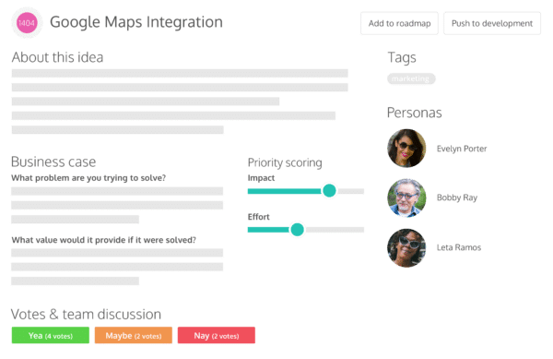
product specifications
You can start building a product spec from the moment you have an idea and keep building on it until you push it over to product development.
The level of detail in your product specs depends on your company, but generally once you’ve defined the above, it’s more effective to leave the details of the final implementation in the hands of the dev team.
The business case: What effect are we expecting it to have on our bottom line? (Include the associated OKRs or KPIs)
User stories: What does the user want to achieve? What is their motivation?
Mockups and sketches: What might the final build look like? (It’s helpful to include feedback)
User personas: Who are we building this for and how will they benefit?
Technical specs: Are there any technical issues to consider?
Customer feedback: What have customers said in the past that we would like to address with this spec?

Slide 63
END of UNIT III

